Slide 1
B+ & B* Trees
Baguio, John Daves
Go, Kashmel Galil
Jumalon, Robine Cole
Perol, Jian Marco

Slide 2
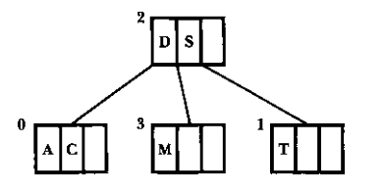


B Trees
B+ Trees
D | S
A | C
D | M
S | T
Leaves are not linked together
Leaves are linked together
Repetition of data
No repetition of data
Data pointers are only present in leaf nodes
Indices to the data are stored in the internal node
Notes:
So in actuality these data in b+ trees are not really repetition of data, the data pointers is located in the leaf node. SO what is stored in the internal node. These are your pointers, pointers to your indices to the data pointers, Since these are the data pointers meaning this is not the actual data

Slide 3
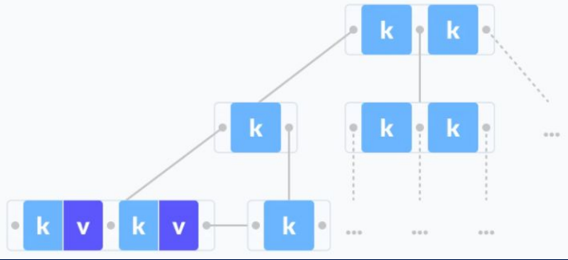
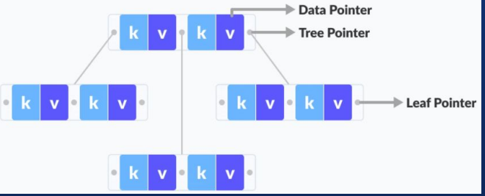
B Trees
B+ Trees
d
disk file - (computer science) a computer file stored on a magnetic disk and identified by a unique label
disk file
Notes:
Notice here your B trees the leaf node and the internal node has their own data pointers but in b trees data pointers are only located in the leaf node. So where does this data pointers pointing to? These data pointers are pointing to your actual data located in the disk file. Disk file ….

Slide 4
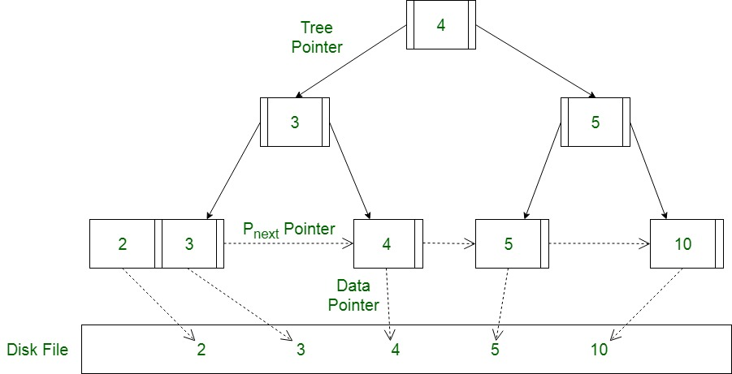
B+ Tree
Self-balancing tree
Main Memory
Secondary Memory
Notes:
B+ tree is a self balancing tree same as B trees that for every height of the root to the leaf nodes are equal
B+ trees come in handy when we want to store a large amount of data in the main memory. Since we know that the size of the main memory is not that large, so make use of the B+ trees, whose internal nodes that store the key(to access the records) are stored in the main memory whereas, the leaf nodes that contain the data pointers are actually stored in the secondary memory.

Slide 5
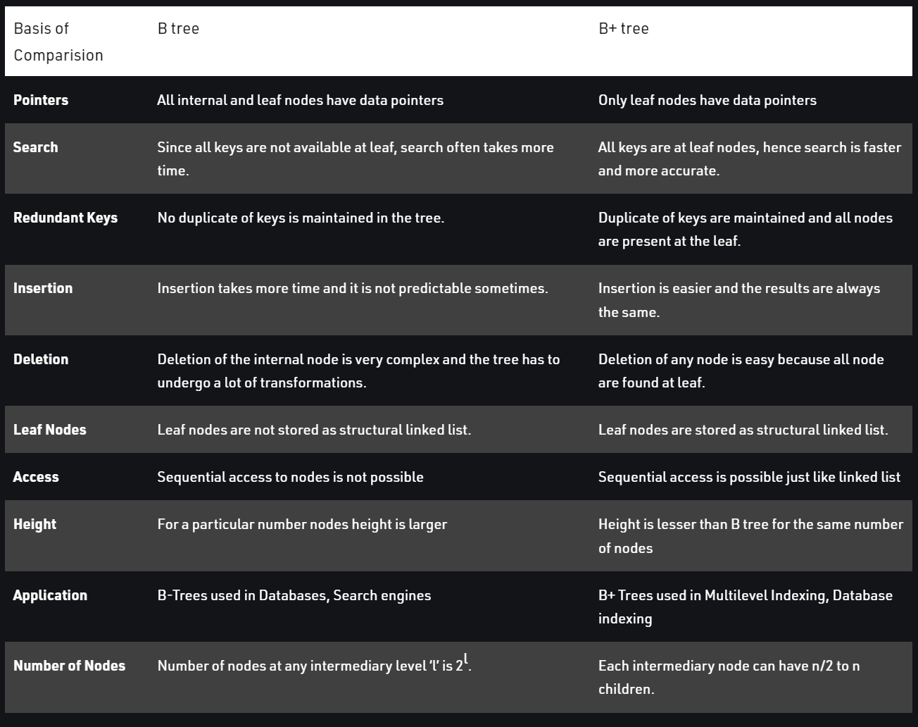
Advantages of B+ Trees
Records can be fetched in equal number of disk accesses.
Height of the tree remains balanced and less as compared to B tree.
We can access the data stored in a B+ tree sequentially as well as directly.
Keys are used for indexing.
Faster search queries as the data is stored only on the leaf nodes

Slide 6
Data Structure & Properties
Key
parent
pointer
next
count
Order = 3
Max children = 3
Max keys = (m-1) = 2
Min children = ⌈m/2⌉ = 2
Min keys = ⌈m/2⌉ - 1 = 1
Notes:
Since a B+ trees is just a variation of a B tree more or less it has the same properties of a B tree but has some additions like data are only located at the leaf nodes and other rules which will discuss later

Slide 7
B+ Trees (Insertion)
Instruction:
Every element is inserted into a leaf node. So, go to the appropriate leaf node.
Data:
15, 5, 25, 35, 45 ,20 ,30 ,40, 55
Order = 3
Max children = 3
Min children = 2
Max keys = 2
Min keys = 1
Overflow
Insert the key into the leaf node in increasing order only if there is no overflow.
K
15
25
C
2
5
15
0
1
P
N
If there is an overflow go to its respective Case
Case 1: Overflow in leaf node
Case 2 Overflow in non leaf node
Notes:
Given this data so the first thing (read first two instructions)
If order is given of a tree is tree then the maximum children … But except for root node, this rules are not applied on root because root node can have 2 children or 0 childe root node can have 0 keys
Notice here that we cannot insert 25 because the maximum keys in a node is 2 so therefore this is an overflow

Slide 8
B+ Trees (Insertion)
Instruction:
Case 1: Overflow in leaf node
Split the leaf node into two nodes.
From the keys, including the key to be inserted, the first node contains ⌈(m-1)/2⌉ keys.
Second node contains the remaining keys.
Copy the smallest search key value from second node to the parent node.
Case 2 Overflow in non leaf node
Data:
15, 5, 25, 35, 45 ,20 ,30 ,40, 55
Order = 3
Max children = 3
Min children = 2
Max keys = 2
Min keys = 1
K
15
C
1
P
N
First node
⌈(3-1)/2⌉
= 1
K
5
15
25
C
1
K
25
C
2
15
0
2
P
N
P
N
Always bottom to top approach
5
15
25
Notes:
Now B tree and B+ tree always grow towards upward, so just like bottom to top approach.
So meaning we will include 25 to its respective position, meaning we cannot just not include 25 in the list just because it was not inserted yet, but we have to pretend that 25 is already inserted in the list. (read continuation) I will discuss a different method later
With this approach we will be doing the right bias tree
We got this method in the geeks for geeks but in most or some sources how they insert their data is by finding the middle element and using that element to be the parent of the keys and left child will be less than the middle element and right will be greater than the middle element

Slide 9
B+ Trees (Insertion Another Method)
Order = 3
Max children = 3
Min children = 2
Max keys = 2
Min keys = 1
K
15
C
1
P
N
K
5
15
25
K
15
25
P
P
C
2
N
C
2
N
1

Slide 10
B+ Trees (Insertion Another Method)
Order = 4
Max children = 4
Min children = 2
Max keys = 3
Min keys = 1
K
16
C
1
P
N
K
5
15
16
25
K
16
25
P
P
C
3
N
C
2
N
2

Slide 11
B+ Trees (Insertion Non Recursive)
K
15
C
1
P
N
K
5
parent
K
15
25
parent
P
N
P
N
C
1
C
2

Slide 12
B+ Trees (Insertion)
Instruction:
Every element is inserted into a leaf node. So, go to the appropriate leaf node.
Insert the key into the leaf node in increasing order only if there is no overflow.
If there is a overflow go to its respective Case
Case 1: Overflow in leaf node
Case 2 Overflow in non leaf node
Data:
15, 5, 25, 35, 45 ,20 ,30 ,40, 55
Order = 3
Max children = 3
Min children = 2
Max keys = 2
Min keys = 1
35
15
>
<
5
15
25
35

Slide 13
B+ Trees (Insertion)
Instruction:
Case 1: Overflow in leaf node
Split the leaf node into two nodes.
From the keys, including the key to be inserted, the first node contains ⌈(m-1)/2⌉ keys.
Second node contains the remaining keys.
Copy the smallest search key value from second node to the parent node.
Case 2 Overflow in non leaf node
Data:
15, 5, 25, 35, 45 ,20 ,30 ,40, 55
Order = 3
Max children = 3
Min children = 2
Max keys = 2
Min keys = 1
First node
= 1
15
25
5
15
25
35
25
35
15
25
35

Slide 14
B+ Trees (Insertion)
Instruction:
Every element is inserted into a leaf node. So, go to the appropriate leaf node.
Insert the key into the leaf node in increasing order only if there is no overflow.
If there is a overflow go to its respective Case
Case 1: Overflow in leaf node
Case 2 Overflow in non leaf node
Data:
15, 5, 25, 35, 45 ,20 ,30 ,40, 55
Order = 3
Max children = 3
Min children = 2
Max keys = 2
Min keys = 1
45
15
25
15 >
25<
15<
25>
5
15
25
35
45

Slide 15
B+ Trees (Insertion)
Instruction:
Case 1: Overflow in leaf node
Split the leaf node into two nodes.
From the keys, including the key to be inserted, the first node contains ⌈(m-1)/2⌉ keys.
Second node contains the remaining keys.
Copy the smallest search key value from second node to the parent node.
Case 2 Overflow in non leaf node
Data:
15, 5, 25, 35, 45 ,20 ,30 ,40, 55
Order = 3
Max children = 3
Min children = 2
Max keys = 2
Min keys = 1
First node
= 1
15
25
35
5
15
25
35
45
35
45
25
35
45

Slide 16
B+ Trees (Insertion)
Instruction:
Case 1: Overflow in leaf node
Case 2 Overflow in non leaf node
Split the non leaf node into two nodes.
First node contains ⌈(m-1)/2⌉ values.
Move the smallest among remaining to the parent.
Second node contains the remaining keys.
Data:
15, 5, 25, 35, 45 ,20 ,30 ,40, 55
Order = 3
Max children = 3
Min children = 2
Max keys = 2
Min keys = 1
25
First node
= 1
15
25
35
35
5
15
25
35
45
15
25
35
Keys cannot be repeated in the internal node
Notes:
So actually the case 1 and case 2 are similar except rule 3 and 4 are interchange
So do you have questions? Yes I have a question, Why wasnt 25 included in the right child? There is a rule in the B+ trees where in (next) , because the data pointers are in teh leaf nodes and in internal nodes we just have indices to our data so what is the point of repeating the same index again adn again we just need 1 indices and using the pointer we can reach to our actual data so that is why in the internal nodes we cannot have the same indices

Slide 17
B+ Trees (Insertion)
Instruction:
Every element is inserted into a leaf node. So, go to the appropriate leaf node.
Insert the key into the leaf node in increasing order only if there is no overflow.
If there is a overflow go to its respective Case
Case 1: Overflow in leaf node
Case 2 Overflow in non leaf node
Data:
15, 5, 25, 35, 45 ,20 ,30 ,40, 55
Order = 3
Max children = 3
Min children = 2
Max keys = 2
Min keys = 1
25
15
35
45
5
15
20
25
30
35
40
45
55

Slide 18
B+ Trees (Deletion)
A
The key to be deleted is present only at the leaf node not in the internal nodes.
CASE A
CASE C
CASE B

Slide 19

B+ Trees (Deletion)
25
15
35
45
CASE 1A
The key to be deleted is present only at the leaf node not in the internal nodes.
5
15
20
25
30
35
40
45
55

Slide 20
B+ Trees (Deletion)
25
CASE 1A
The key to be deleted is present only at the leaf node not in the internal nodes.
15
35
45
5
15
20
25
30
45
55
K
35
40
P
C
2
N

Slide 21
B+ Trees (Deletion)
25
CASE 1A
The key to be deleted is present only at the leaf node not in the internal nodes.
15
35
45
5
15
20
25
30
45
55
K
35
NIL
P
C
1
N

Slide 22
B+ Trees (Deletion)
25
15
35
45
CASE 2A
There is an exact minimum number of keys in the node.
5
15
20
25
30
35
45
55
Recall:
A node (except root node) should contain a minimum of ⌈m/2⌉ - 1 keys.
Underflow is a situation when there is less number of keys in a node than the minimum number of keys it should hold

Slide 23
B+ Trees (Deletion)
25
…
K
15
NIL
CASE 2A
P
NIL
There is an exact minimum number of keys in the node.
C
1
N
K
5
NIL
K
15
20
Step 1:
Borrow a key left (less) of the median node to be put in the node where the deletion happened
P
P
C
1
N
C
2
N
…

Slide 24
B+ Trees (Deletion)
25
…
K
15
NIL
CASE 2A
P
NIL
There is an exact minimum number of keys in the node.
C
1
N
K
15
NIL
K
20
NIL
Step 1:
Borrow a key left (less) of the median node to be put in the node where the deletion happened
P
P
…
C
1
N
C
1
N
…

Slide 25
B+ Trees (Deletion)
25
…
K
20
NIL
CASE 2A
P
NIL
There is an exact minimum number of keys in the node.
C
1
N
K
15
NIL
K
20
NIL
Step 2:
Add the median key of the sibling node to the parent
P
P
C
1
N
C
1
N
…

Slide 26
B+ Trees (Deletion)
25
20
35
45
CASE 2A
There is an exact minimum number of keys in the node.
15
20
25
30
35
45
55

Slide 27
B+ Trees (Deletion)
A
The key to be deleted is present only at the leaf node not in the internal nodes. There are 2 cases for it
CASE A
CASE C
B
The key to be deleted is present in the internal nodes as well. Then we have to remove them from the internal nodes as too.
CASE B

Slide 28
B+ Trees (Deletion)
25
20
35
45
CASE 1B
The key to be deleted is present in the internal nodes as well.
15
20
25
30
35
45
55
Step 1:
Just delete it immediately.
Notes:
If there is more than the minimum number of keys in the node, simply delete the key from the leaf node and delete the key from the internal node as well.

Slide 29
B+ Trees (Deletion)
CASE 1B
The key to be deleted is present in the internal nodes as well.
25
…
35
45
Step 1:
Just delete it immediately. Then update the keys in the nodes from bottom to top
2
N
K
25
30
35
NIL
45
55
P
C
2
N
1
N
2
N
Notes:
If there is more than the minimum number of keys in the node, simply delete the key from the leaf node and delete the key from the internal node as well.

Slide 30
B+ Trees (Deletion)
CASE 1B
The key to be deleted is present in the internal nodes as well.
25
…
35
45
Step 2:
Fill the empty space in the internal node with the inorder successor
2
N
K
25
30
35
NIL
55
NIL
P
C
2
N
1
N
1
N
Notes:
If there is more than the minimum number of keys in the node, simply delete the key from the leaf node and delete the key from the internal node as well.

Slide 31
B+ Trees (Deletion)
CASE 1B
The key to be deleted is present in the internal nodes as well.
25
…
35
55
Step 2:
Fill the empty space in the internal node with the inorder successor
2
N
K
25
30
35
NIL
55
NIL
P
C
2
N
1
N
1
N
Notes:
If there is more than the minimum number of keys in the node, simply delete the key from the leaf node and delete the key from the internal node as well.

Slide 32
B+ Trees (Deletion)
25
20
35
55
CASE 1B
The key to be deleted is present in the internal nodes as well.
15
20
25
30
35
55
Notes:
If there is more than the minimum number of keys in the node, simply delete the key from the leaf node and delete the key from the internal node as well.

Slide 33
B+ Trees (Deletion)
25
20
35
55
CASE 2B
If there is an exact minimum number of keys in the node
15
20
25
30
35
55
Step 1:
Delete the key
Notes:
If there is more than the minimum number of keys in the node, simply delete the key from the leaf node and delete the key from the internal node as well.

Slide 34
B+ Trees (Deletion)
CASE 2B
The key to be deleted is present in the internal nodes as well.
25
…
35
55
Step 1:
Delete the key from the leaf node.
2
N
K
25
30
35
NIL
55
NIL
P
C
2
N
1
N
1
N
Notes:
If there is more than the minimum number of keys in the node, simply delete the key from the leaf node and delete the key from the internal node as well.

Slide 35
B+ Trees (Deletion)
CASE 2B
The key to be deleted is present in the internal nodes as well.
25
…
30
55
Step 2:
Since, the node was in the exact min. no. of keys, we borrow from our sibling and then update the keys above
2
N
K
25
NIL
30
NIL
55
NIL
P
C
1
N
1
N
1
N
Notes:
If there is more than the minimum number of keys in the node, simply delete the key from the leaf node and delete the key from the internal node as well.

Slide 36
B+ Trees (Deletion)
25
20
30
55
CASE 2B
If there is an exact minimum number of keys in the node
15
20
25
30
55
Notes:
If there is more than the minimum number of keys in the node, simply delete the key from the leaf node and delete the key from the internal node as well.

Slide 37
B+ Trees (Deletion)
25
20
30
55
CASE 3B
Empty space is generated above the immediate parent node
15
20
25
30
55
Step 1:
Delete the key
Notes:
This case is similar to Case II(1) but here, empty space is generated above the immediate parent node. After deleting the key, merge the empty space with its sibling.
Fill the empty space in the grandparent node with the inorder successor.

Slide 38
B+ Trees (Deletion)
CASE 2B
K
25
NIL
P
The key to be deleted is present in the internal nodes as well.
C
1
N
Step 1:
…
30
55
Delete the key
2
N
K
25
NIL
30
NIL
55
NIL
P
C
N
1
N
1
N
1
Notes:
If there is more than the minimum number of keys in the node, simply delete the key from the leaf node and delete the key from the internal node as well.

Slide 39
B+ Trees (Deletion)
CASE 2B
K
25
NIL
P
The key to be deleted is present in the internal nodes as well.
C
1
N
Step 2:
…
30
55
We can then free the empty node,
2
N
K
NIL
NIL
30
NIL
55
NIL
P
C
N
0
N
1
N
1
Notes:
If there is more than the minimum number of keys in the node, simply delete the key from the leaf node and delete the key from the internal node as well.

Slide 40
B+ Trees (Deletion)
CASE 2B
K
25
NIL
P
The key to be deleted is present in the internal nodes as well.
C
1
N
Step 3:
…
30
55
Since, we’re working from bottom to top, update the keys
2
N
30
NIL
55
NIL
N
1
N
1
Notes:
If there is more than the minimum number of keys in the node, simply delete the key from the leaf node and delete the key from the internal node as well.

Slide 41
B+ Trees (Deletion)
CASE 2B
K
30
NIL
P
The key to be deleted is present in the internal nodes as well.
C
1
N
Step 3:
…
55
NIL
Since, we’re working from bottom to top, update the keys
1
N
30
NIL
55
NIL
N
1
N
1
Notes:
If there is more than the minimum number of keys in the node, simply delete the key from the leaf node and delete the key from the internal node as well.

Slide 42
B+ Trees (Deletion)
30
20
55
CASE 3B
Empty space is generated above the immediate parent node
15
20
30
55
Notes:
This case is similar to Case II(1) but here, empty space is generated above the immediate parent node. After deleting the key, merge the empty space with its sibling.
Fill the empty space in the grandparent node with the inorder successor.

Slide 43
B+ Trees (Deletion)
A
The key to be deleted is present only at the leaf node not in the internal nodes. There are 2 cases for it
CASE A
CASE C
B
The key to be deleted is present in the internal nodes as well. Then we have to remove them from the internal nodes as too.
CASE B
C
The height of the tree gets shrinked.

Slide 44
B+ Trees (Deletion)
30
20
55
CASE C
Height of the tree gets shrinked
15
20
30
55
Step 1:
Delete the key
Notes:
This case is similar to Case II(1) but here, empty space is generated above the immediate parent node. After deleting the key, merge the empty space with its sibling.
Fill the empty space in the grandparent node with the inorder successor.

Slide 45
B+ Trees (Deletion)
CASE C
K
30
NIL
P
Height of the tree gets shrinked
C
1
N
Step 1:
…
55
NIL
Delete the keys
1
N
30
NIL
55
NIL
N
1
N
1
Notes:
If there is more than the minimum number of keys in the node, simply delete the key from the leaf node and delete the key from the internal node as well.

Slide 46
B+ Trees (Deletion)
CASE C
K
30
NIL
P
Height of the tree gets shrinked
C
1
N
Step 2:
…
55
NIL
We see that 30 will be parentless once we free the node containing 55
1
N
30
NIL
1
N
Notes:
If there is more than the minimum number of keys in the node, simply delete the key from the leaf node and delete the key from the internal node as well.

Slide 47
B+ Trees (Deletion)
CASE C
Height of the tree gets shrinked
K
30
NIL
P
C
1
N
Step 3:
Just merge the grandparent to an immediate child then let it point to the node containing 30
20
NIL
1
N
30
NIL
…
…
1
N
Notes:
If there is more than the minimum number of keys in the node, simply delete the key from the leaf node and delete the key from the internal node as well.

Slide 48
B+ Trees (Deletion)
CASE C
Height of the tree gets shrinked
Step 3:
Just merge the grandparent to an immediate child then let it point to the node containing 30
20
30
1
N
30
NIL
…
…
1
N
Notes:
If there is more than the minimum number of keys in the node, simply delete the key from the leaf node and delete the key from the internal node as well.

Slide 49
B+ Trees (Deletion)
20
30
CASE C
Height of the tree gets shrinked
15
20
30
Step 3:
Let the node where the merging happens point to the node that was left behind after the deletion
Notes:
This case is similar to Case II(1) but here, empty space is generated above the immediate parent node. After deleting the key, merge the empty space with its sibling.
Fill the empty space in the grandparent node with the inorder successor.

Slide 50
B+ Trees (Search)
k = 45
25
15
35
45
5
15
20
25
30
35
40
45
55

Slide 51
B+ Trees (Search)
Compare k with root node
25
15
35
45
5
15
20
25
30
35
40
45
55
k = 45
Notes:
Faster Access, Operation is faster, height is less than the B tree,

Slide 52
B+ Trees (Search)
k > 25 go to right child
25
15
35
45
5
15
20
25
30
35
40
45
55
k = 45
Notes:
Faster Access, Operation is faster, height is less than the B tree,

Slide 53
B+ Trees (Search)
Compare k with 35
25
15
35
45
5
15
20
25
30
35
40
45
55
k = 45
Notes:
Faster Access, Operation is faster, height is less than the B tree,

Slide 54
B+ Trees (Search)
Compare k with 45
25
15
35
45
5
15
20
25
30
35
40
45
55
k = 45
Notes:
Faster Access, Operation is faster, height is less than the B tree,

Slide 55
B+ Trees (Search)
k ≥ 45
25
Go to right child
15
35
45
5
15
20
25
30
35
40
45
55
k = 45
Notes:
Faster Access, Operation is faster, height is less than the B tree,

Slide 56
B+ Trees (Search)
k is found
25
15
35
45
5
15
20
25
30
35
40
45
55
k = 45

Slide 57
Time Complexity
 | Best | Worst | Space
Insertion | O(logn) | O(logn) | O(n)
Deletion | O(logn) | O(logn) | O(n)
Search | O(logn) | O(logn) | O(n)
Notes:
Faster Access, Operation is faster, height is less than the B tree,

Slide 58
B* Trees

Slide 59
B* Tree
B*-tree of order m is a search tree that is either empty or that satisfies these properties:
Every node has a maximum of m descendents
Every node except for the root and the leaves has at least (2m - 1)/3 descendents.
The root has at least two descendents
All the leaves appear on the same level.
A leaf node contains at least floor((2m - 1)/3) keys and no more than m - 1 keys
The size of the root is larger than other nodes

Slide 60
B* Trees (Insertion)
Instruction:
If the tree is empty, allocate a root node with the size of ((2m - 1)/3) * 2 and insert the key
Search the appropriate node for insertion and insert the key in ascending order.
If the node is full:
Check if left sibling is not full and not empty
Proceed to 4.
Check if right sibling is not full and not empty
Proceed to 4.
Else
Proceed to 5
Determine the middle element
…
Perform a 2-3 split
…
Order = 5
Max children = 5
Min children = 3
Max keys = 4
Min keys = 3
Data:
1, 13, 8, 4, 6, 2, 7 , 3, 11, 15
Insert: 1
((2m - 1)/3) * 2 = 6

Slide 61
B* Trees (Insertion)
Instruction:
If the tree is empty, allocate a root node with the size of ((2m - 1)/3) * 2 and insert the key
Search the appropriate node for insertion and insert the key in ascending order.
If the node is full:
Check if left sibling is not full and not empty
Proceed to 4.
Check if right sibling is not full and not empty
Proceed to 4.
Else
Proceed to 5
Determine the middle element
…
Perform a 2-3 split
…
Order = 5
Max children = 5
Min children = 3
Max keys = 4
Min keys = 3
Data:
1, 13, 8, 4, 6, 2, 7 , 3, 11, 15
Insert: 1
1

Slide 62
B* Trees (Insertion)
Instruction:
If the tree is empty, allocate a root node with the size of ((2m - 1)/3) * 2 and insert the key
Search the appropriate node for insertion and insert the key in ascending order.
If the node is full:
Check if left sibling is not full and not empty
Proceed to 4.
Check if right sibling is not full and not empty
Proceed to 4.
Else
Proceed to 5
Determine the middle element
…
Perform a 2-3 split
…
Order = 5
Max children = 5
Min children = 3
Max keys = 4
Min keys = 3
Data:
1, 13, 8, 4, 6, 2, 7 , 3, 11, 15
Insert: 13
1
13

Slide 63
B* Trees (Insertion)
Instruction:
If the tree is empty, allocate a root node with the size of ((2m - 1)/3) * 2 and insert the key
Search the appropriate node for insertion and insert the key in ascending order.
If the node is full:
Check if left sibling is not full and not empty
Proceed to 4.
Check if right sibling is not full and not empty
Proceed to 4.
Else
Proceed to 5
Determine the middle element
…
Perform a 2-3 split
…
Order = 5
Max children = 5
Min children = 3
Max keys = 4
Min keys = 3
Data:
1, 13, 8, 4, 6, 2, 7 , 3, 11, 15
Insert: 8
1
8
13
13

Slide 64
B* Trees (Insertion)
Instruction:
If the tree is empty, allocate a root node with the size of ((2m - 1)/3) * 2 and insert the key
Search the appropriate node for insertion and insert the key in ascending order.
If the node is full:
Check if left sibling is not full and not empty
Proceed to 4.
Check if right sibling is not full and not empty
Proceed to 4.
Else
Proceed to 5
Determine the middle element
…
Perform a 2-3 split
…
Order = 5
Max children = 5
Min children = 3
Max keys = 4
Min keys = 3
Data:
1, 13, 8, 4, 6, 2, 7 , 3, 11, 15
Insert: 7
1 | 2 | 4 | 6 | 8 | 13
1 | 2 | 4 | 6 | 7 | 8 | 13

Slide 65
B* Trees (Insertion)
Instruction:
If the tree is empty, allocate a root node with the size of ((2m - 1)/3) * 2 and insert the key
Search the appropriate node for insertion and insert the key in ascending order.
If the node is full:
Check if left sibling is not full and not empty
Proceed to 4.
Check if right sibling is not full and not empty
Proceed to 4.
Else
Proceed to 5
Determine the middle element
…
Perform a 2-3 split
…
Order = 5
Max children = 5
Min children = 3
Max keys = 4
Min keys = 3
Data:
1, 13, 8, 4, 6, 2, 7 , 3, 11, 15
Insert: 7
1 | 2 | 4 | 6 | 8 | 13
6
1 | 2 | 4
7 | 8 | 13
1 | 2 | 4 | 6 | 7 | 8 | 13

Slide 66
B* Trees (Insertion)
Instruction:
If the tree is empty, allocate a root node with the size of ((2m - 1)/3) * 2 and insert the key
Search the appropriate node for insertion and insert the key in ascending order.
If the node is full:
Check if left sibling is not full and not empty
Proceed to 4.
Check if right sibling is not full and not empty
Proceed to 4.
Else
Proceed to 5
Determine the middle element
…
Perform a 2-3 split
…
Order = 5
Max children = 5
Min children = 3
Max keys = 4
Min keys = 3
Data:
1, 13, 8, 4, 6, 2, 7 , 11, 15, 3
Insert: 11
6
1 | 2 | 4
7 | 8 | 13

Slide 67
B* Trees (Insertion)
Instruction:
If the tree is empty, allocate a root node with the size of ((2m - 1)/3) * 2 and insert the key
Search the appropriate node for insertion and insert the key in ascending order.
If the node is full:
Check if left sibling is not full and not empty
Proceed to 4.
Check if right sibling is not full and not empty
Proceed to 4.
Else
Proceed to 5
Determine the middle element
…
Perform a 2-3 split
…
Order = 5
Max children = 5
Min children = 3
Max keys = 4
Min keys = 3
Data:
1, 13, 8, 4, 6, 2, 7 , 11, 15, 3
Insert: 11
6
1 | 2 | 4
7 | 8 | 11 | 13

Slide 68
B* Trees (Insertion)
Instruction:
If the tree is empty, allocate a root node with the size of ((2m - 1)/3) * 2 and insert the key
Search the appropriate node for insertion and insert the key in ascending order.
If the node is full:
Check if left sibling is not full and not empty
Proceed to 4.
Check if right sibling is not full and not empty
Proceed to 4.
Else
Proceed to 5
Determine the middle element
…
Perform a 2-3 split
…
Order = 5
Max children = 5
Min children = 3
Max keys = 4
Min keys = 3
Data:
1, 13, 8, 4, 6, 2, 7 , 11, 15, 3
Insert: 15
6
1 | 2 | 4
7 | 8 | 11 | 13

Slide 69
B* Trees (Insertion)
Instruction:
If the tree is empty, allocate a root node with the size of ((2m - 1)/3) * 2 and insert the key
Search the appropriate node for insertion and insert the key in ascending order.
If the node is full:
…
Determine the middle element
Place the left child keys, parent key, the right child keys and the key to be inserted in a temporary array
Find the middle element and it will replace the current parent
Fill the left and right child
Perform a 2-3 split
…
Order = 5
Max children = 5
Min children = 3
Max keys = 4
Min keys = 3
Data:
1, 13, 8, 4, 6, 2, 7 , 11, 15, 3
Insert: 15
6
1 | 2 | 4
7 | 8 | 11 | 13
1 | 2 | 4 | 6 | 7 | 8 | 11 | 13

Slide 70
B* Trees (Insertion)
Instruction:
If the tree is empty, allocate a root node with the size of ((2m - 1)/3) * 2 and insert the key
Search the appropriate node for insertion and insert the key in ascending order.
If the node is full:
…
Determine the middle element
Place the left child keys, parent key, the right child keys and the key to be inserted in a temporary array
Find the middle element and it will replace the current parent
Fill the left and right child
Perform a 2-3 split
…
Order = 5
Max children = 5
Min children = 3
Max keys = 4
Min keys = 3
Data:
1, 13, 8, 4, 6, 2, 7 , 11, 15, 3
Insert: 15
7
1 | 2 | 4
7 | 8 | 11 | 13
1 | 2 | 4 | 6 | 7 | 8 | 11 | 13

Slide 71
B* Trees (Insertion)
Instruction:
If the tree is empty, allocate a root node with the size of ((2m - 1)/3) * 2 and insert the key
Search the appropriate node for insertion and insert the key in ascending order.
If the node is full:
…
Determine the middle element
Place the left child keys, parent key, the right child keys and the key to be inserted in a temporary array
Find the middle element and it will replace the current parent
Fill the left and right child
Perform a 2-3 split
…
Order = 5
Max children = 5
Min children = 3
Max keys = 4
Min keys = 3
Data:
1, 13, 8, 4, 6, 2, 7 , 11, 15, 3
Insert: 15
7
1 | 2 | 4 | 6
8 | 11 | 13 | 15
1 | 2 | 4 | 6 | 7 | 8 | 11 | 13 | 15

Slide 72
B* Trees (Insertion)
Instruction:
If the tree is empty, allocate a root node with the size of ((2m - 1)/3) * 2 and insert the key
Search the appropriate node for insertion and insert the key in ascending order.
If the node is full:
Check if left sibling is not full and not empty
Proceed to 4.
Check if right sibling is not full and not empty
Proceed to 4.
Else
Proceed to 5
Determine the middle element
…
Perform a 2-3 split
…
Order = 5
Max children = 5
Min children = 3
Max keys = 4
Min keys = 3
Data:
1, 13, 8, 4, 6, 2, 7 , 11, 15, 3
Insert: 3
7
1 | 2 | 4 | 6
8 | 11 | 13 | 15

Slide 73
B* Trees (Insertion)
Instruction:
…
…
…
…
Perform a 2-3 split
Place the left child keys, parent key, the right child key and the key to be inserted in a temporary array
The element at index (2m – 2)/3 will be the first parent, keys less than the first parent will be place in the first node
The element at index (4m)/3 will be the second parent, keys less than the second parent but greater than the first parent will be place at the second node
Keys greater than the second parent will be place at the third node
Order = 5
Max children = 5
Min children = 3
Max keys = 4
Min keys = 3
Data:
1, 13, 8, 4, 6, 2, 7 , 11, 15, 3
Insert: 3
7
1 | 2 | 4 | 6
8 | 11 | 13 | 15
(2(5) - 2) / 3 = 2
1 | 2 | 3 | 4 | 6 | 7 | 8 | 11 | 13 | 15

Slide 74
B* Trees (Insertion)
Instruction:
…
…
…
…
Perform a 2-3 split
Place the left child keys, parent key, the right child key and the key to be inserted in a temporary array
The element at index (2m – 2)/3 will be the first parent, keys less than the first parent will be place in the first node
The element at index (4m)/3 will be the second parent, keys less than the second parent but greater than the first parent will be place at the second node
Keys greater than the second parent will be place at the third node
Order = 5
Max children = 5
Min children = 3
Max keys = 4
Min keys = 3
Data:
1, 13, 8, 4, 6, 2, 7 , 11, 15, 3
Insert: 3
3
1 | 2
8 | 11 | 13 | 15
(4(5))/3 = 6
1 | 2 | 3 | 4 | 6 | 7 | 8 | 11 | 13 | 15

Slide 75
B* Trees (Insertion)
Instruction:
…
…
…
…
Perform a 2-3 split
Place the left child keys, parent key, the right child key and the key to be inserted in a temporary array
The element at index (2m – 2)/3 will be the first parent, keys less than the first parent will be place in the first node
The element at index (4m)/3 will be the second parent, keys less than the second parent but greater than the first parent will be place at the second node
Keys greater than the second parent will be place at the third node
Order = 5
Max children = 5
Min children = 3
Max keys = 4
Min keys = 3
Data:
1, 13, 8, 4, 6, 2, 7 , 11, 15, 3
Insert: 3
3 | 8
1 | 2
4 | 6 | 7
11 | 13 | 15
(4(5))/3 = 6
1 | 2 | 3 | 4 | 6 | 7 | 8 | 11 | 13 | 15

Slide 76
B* Trees (Insertion)
Instruction:
If the tree is empty, allocate a root node with the size of ((2m - 1)/3) * 2 and insert the key
Search the appropriate node for insertion and insert the key in ascending order.
If the node is full:
Check if left sibling is not full and not empty
Proceed to 4.
Check if right sibling is not full and not empty
Proceed to 4.
Else
Proceed to 5
Determine the middle element
…
Perform a 2-3 split
…
Order = 5
Max children = 5
Min children = 3
Max keys = 4
Min keys = 3
Data:
1, 13, 8, 4, 6, 2, 7 , 11, 15, 3
Insert: 3
3 | 8
1 | 2
11 | 13 | 15
4 | 6 | 7
Cons: violation of the rule if order is odd

Slide 80
B* Trees (Deletion)
Case:
If the key to be deleted is not in a leaf, replace it with its predecessor, which is in a leaf
If the leaf now contains at least the minimum number of keys, no further action is required.
If the leaf now contains one too few keys, look at the left and right siblings.
If a sibling has more than the minimum number of keys, redistribute.
If neither sibling has more than the minimum, concatenate.
Delete: 9
10 | 15
2 | 4 | 8 | 9
20 | 25 | 30 | 35
11 | 12 | 13 | 14
Order = 5
Max children = 5
Min children = 3
Max keys = 4
Min keys = 2

Slide 81
B* Trees (Deletion)
Case:
If the key to be deleted is not in a leaf, replace it with its predecessor, which is in a leaf
If the leaf now contains at least the minimum number of keys, no further action is required.
If the leaf now contains one too few keys, look at the left and right siblings.
If a sibling has more than the minimum number of keys, redistribute.
If neither sibling has more than the minimum, concatenate.
Delete: 9
10 | 15
2 | 4 | 8
20 | 25 | 30 | 35
11 | 12 | 13 | 14
Order = 5
Max children = 5
Min children = 3
Max keys = 4
Min keys = 2

Slide 82
B* Trees (Deletion)
Case:
If the key to be deleted is not in a leaf, replace it with its predecessor, which is in a leaf
If the leaf now contains at least the minimum number of keys, no further action is required.
If the leaf now contains one too few keys, look at the left and right siblings.
If a sibling has more than the minimum number of keys, redistribute.
If neither sibling has more than the minimum, concatenate.
Delete: 15
10 | 15
2 | 4 | 8
20 | 25 | 30 | 35
11 | 12 | 13 | 14
Order = 5
Max children = 5
Min children = 3
Max keys = 4
Min keys = 2

Slide 83
B* Trees (Deletion)
Case:
If the key to be deleted is not in a leaf, replace it with its predecessor, which is in a leaf
If the leaf now contains at least the minimum number of keys, no further action is required.
If the leaf now contains one too few keys, look at the left and right siblings.
If a sibling has more than the minimum number of keys, redistribute.
If neither sibling has more than the minimum, concatenate.
Delete: 15
10 | 14
2 | 4 | 8
20 | 25 | 30 | 35
11 | 12 | 13
Order = 5
Max children = 5
Min children = 3
Max keys = 4
Min keys = 2

Slide 84
B* Trees (Deletion)
Case:
If the key to be deleted is not in a leaf, replace it with its predecessor, which is in a leaf
If the leaf now contains at least the minimum number of keys, no further action is required.
If the leaf now contains one too few keys, look at the left and right siblings.
If a sibling has more than the minimum number of keys, redistribute.
If neither sibling has more than the minimum, concatenate.
Delete: 15
10 | 14
2 | 4 | 8
20 | 25 | 30 | 35
11 | 12 | 13
Order = 5
Max children = 5
Min children = 3
Max keys = 4
Min keys = 2

Slide 85
B* Trees (Deletion)
Case:
If the key to be deleted is not in a leaf, replace it with its predecessor, which is in a leaf
If the leaf now contains at least the minimum number of keys, no further action is required.
If the leaf now contains one too few keys, look at the left and right siblings.
If a sibling has more than the minimum number of keys, redistribute.
If neither sibling has more than the minimum, concatenate.
Delete: 8
10 | 14
2 | 4 | 8
20 | 25 | 30 | 35
11 | 12 | 13
Order = 5
Max children = 5
Min children = 3
Max keys = 4
Min keys = 2

Slide 86
B* Trees (Deletion)
Case:
If the key to be deleted is not in a leaf, replace it with its predecessor, which is in a leaf
If the leaf now contains at least the minimum number of keys, no further action is required.
If the leaf now contains one too few keys, look at the left and right siblings.
If a sibling has more than the minimum number of keys, redistribute.
If neither sibling has more than the minimum, concatenate.
Delete: 8
10 | 14
2 | 4
20 | 25 | 30 | 35
11 | 12 | 13
Order = 5
Max children = 5
Min children = 3
Max keys = 4
Min keys = 2

Slide 87
B* Trees (Deletion)
Case:
If the key to be deleted is not in a leaf, replace it with its predecessor, which is in a leaf
If the leaf now contains at least the minimum number of keys, no further action is required.
If the leaf now contains one too few keys, look at the left and right siblings.
If a sibling has more than the minimum number of keys, redistribute.
If neither sibling has more than the minimum, concatenate.
Delete: 4
10 | 14
2 | 4
20 | 25 | 30 | 35
11 | 12 | 13
Order = 5
Max children = 5
Min children = 3
Max keys = 4
Min keys = 2

Slide 88
B* Trees (Deletion)
Case:
If the key to be deleted is not in a leaf, replace it with its predecessor, which is in a leaf
If the leaf now contains at least the minimum number of keys, no further action is required.
If the leaf now contains one too few keys, look at the left and right siblings.
If a sibling has more than the minimum number of keys, redistribute.
If neither sibling has more than the minimum, concatenate.
Delete: 4
10 | 14
2
20 | 25 | 30 | 35
11 | 12 | 13
Order = 5
Max children = 5
Min children = 3
Max keys = 4
Min keys = 2

Slide 89
B* Trees (Deletion)
Case:
If the key to be deleted is not in a leaf, replace it with its predecessor, which is in a leaf
If the leaf now contains at least the minimum number of keys, no further action is required.
If the leaf now contains one too few keys, look at the left and right siblings.
If a sibling has more than the minimum number of keys, redistribute.
If neither sibling has more than the minimum, concatenate.
Delete: 4
 | 14
2 | 10
20 | 25 | 30 | 35
11 | 12 | 13
Order = 5
Max children = 5
Min children = 3
Max keys = 4
Min keys = 2

Slide 90
B* Trees (Deletion)
Case:
If the key to be deleted is not in a leaf, replace it with its predecessor, which is in a leaf
If the leaf now contains at least the minimum number of keys, no further action is required.
If the leaf now contains one too few keys, look at the left and right siblings.
If a sibling has more than the minimum number of keys, redistribute.
If neither sibling has more than the minimum, concatenate.
Delete: 4
11 | 14
2 | 10
20 | 25 | 30 | 35
12 | 13
Order = 5
Max children = 5
Min children = 3
Max keys = 4
Min keys = 2

Slide 91
B* Trees (Deletion)
Case:
If the key to be deleted is not in a leaf, replace it with its predecessor, which is in a leaf
If the leaf now contains at least the minimum number of keys, no further action is required.
If the leaf now contains one too few keys, look at the left and right siblings.
If a sibling has more than the minimum number of keys, redistribute.
If neither sibling has more than the minimum, concatenate.
Delete: 10
11 | 14
2 | 10
20 | 25 | 30 | 35
12 | 13
Order = 5
Max children = 5
Min children = 3
Max keys = 4
Min keys = 2

Slide 92
B* Trees (Deletion)
Case:
If the key to be deleted is not in a leaf, replace it with its predecessor, which is in a leaf
If the leaf now contains at least the minimum number of keys, no further action is required.
If the leaf now contains one too few keys, look at the left and right siblings.
If a sibling has more than the minimum number of keys, redistribute.
If neither sibling has more than the minimum, concatenate.
Delete: 10
11 | 14
2
20 | 25 | 30 | 35
12 | 13
Order = 5
Max children = 5
Min children = 3
Max keys = 4
Min keys = 2

Slide 93
B* Trees (Deletion)
Case:
If the key to be deleted is not in a leaf, replace it with its predecessor, which is in a leaf
If the leaf now contains at least the minimum number of keys, no further action is required.
If the leaf now contains one too few keys, look at the left and right siblings.
If a sibling has more than the minimum number of keys, redistribute.
If neither sibling has more than the minimum, concatenate.
Delete: 10
11 | 14
2
20 | 25 | 30 | 35
12 | 13
Order = 5
Max children = 5
Min children = 3
Max keys = 4
Min keys = 2

Slide 94
B* Trees (Deletion)
Case:
If the key to be deleted is not in a leaf, replace it with its predecessor, which is in a leaf
If the leaf now contains at least the minimum number of keys, no further action is required.
If the leaf now contains one too few keys, look at the left and right siblings.
If a sibling has more than the minimum number of keys, redistribute.
If neither sibling has more than the minimum, concatenate.
Delete: 10
 | 14
2 | 11
20 | 25 | 30 | 35
12 | 13
Order = 5
Max children = 5
Min children = 3
Max keys = 4
Min keys = 2

Slide 95
B* Trees (Deletion)
Case:
If the key to be deleted is not in a leaf, replace it with its predecessor, which is in a leaf
If the leaf now contains at least the minimum number of keys, no further action is required.
If the leaf now contains one too few keys, look at the left and right siblings.
If a sibling has more than the minimum number of keys, redistribute.
If neither sibling has more than the minimum, concatenate.
Delete: 10
 | 14
2 | 11 | 12 | 13
20 | 25 | 30 | 35
Order = 5
Max children = 5
Min children = 3
Max keys = 4
Min keys = 2

Slide 96
B* Trees (Deletion)
Case:
If the key to be deleted is not in a leaf, replace it with its predecessor, which is in a leaf
If the leaf now contains at least the minimum number of keys, no further action is required.
If the leaf now contains one too few keys, look at the left and right siblings.
If a sibling has more than the minimum number of keys, redistribute.
If neither sibling has more than the minimum, concatenate.
Delete: 10
14
2 | 11 | 12 | 13
20 | 25 | 30 | 35
Order = 5
Max children = 5
Min children = 3
Max keys = 4
Min keys = 2

